Slide 1


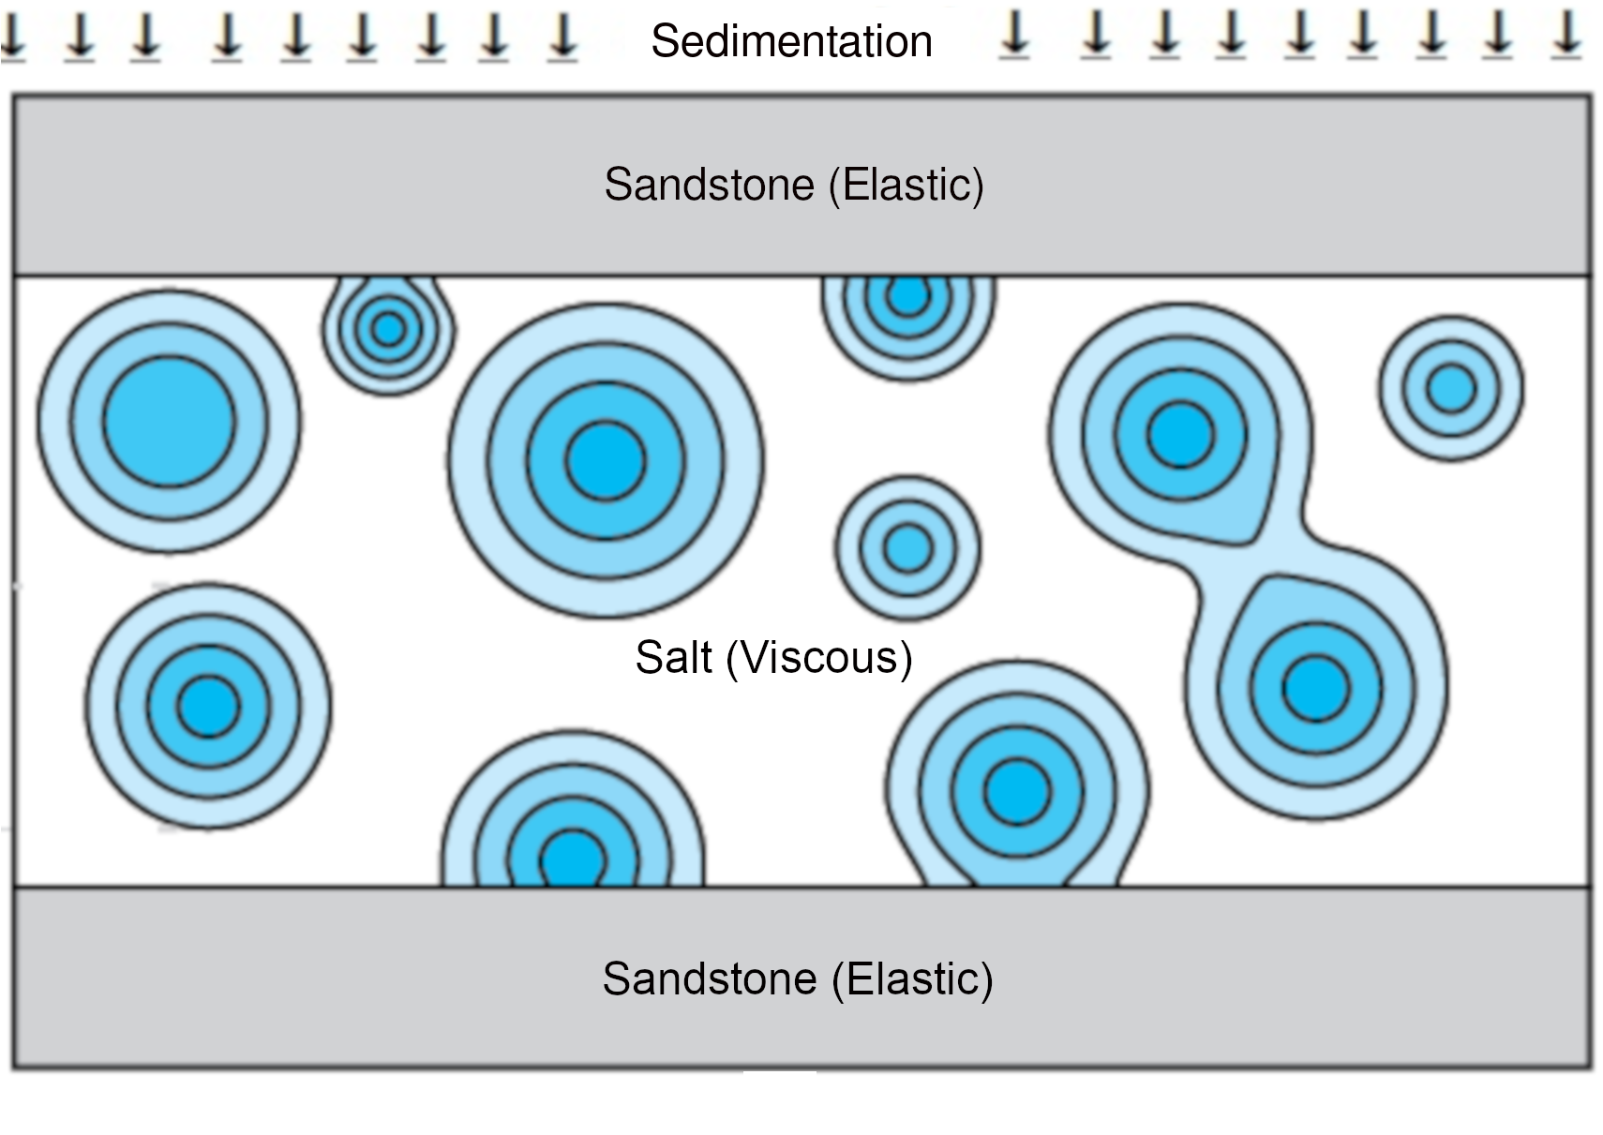
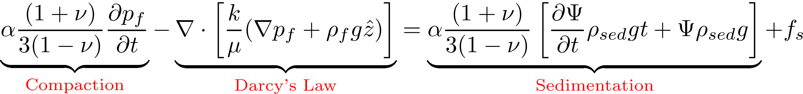
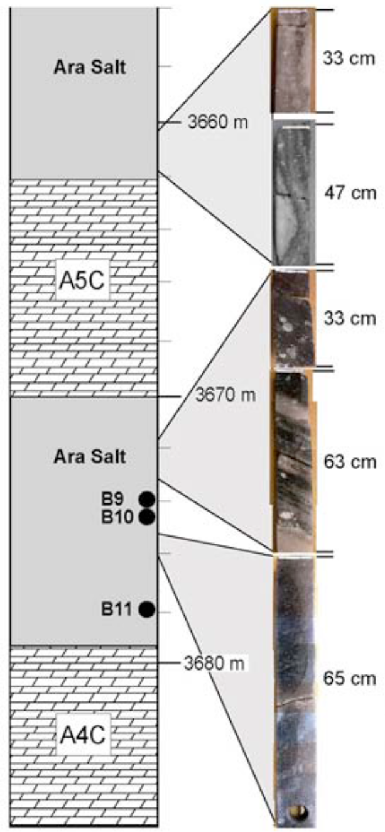
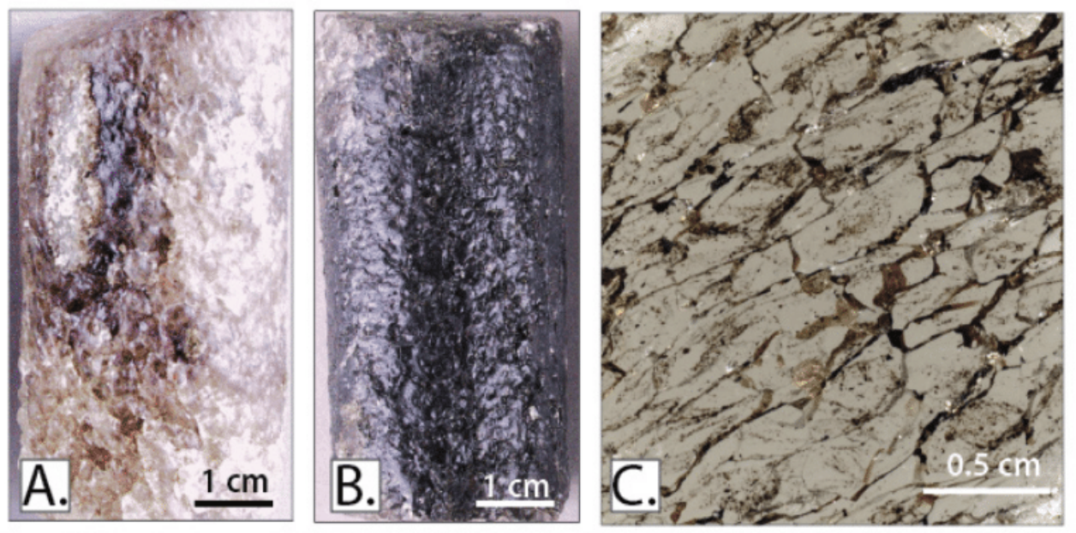
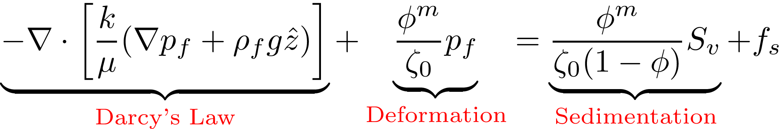
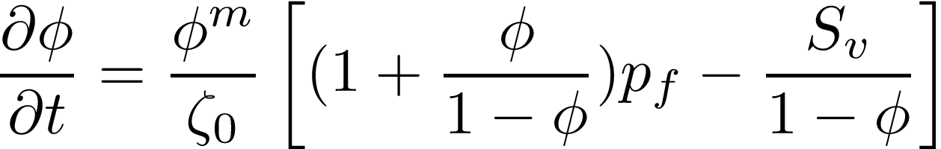
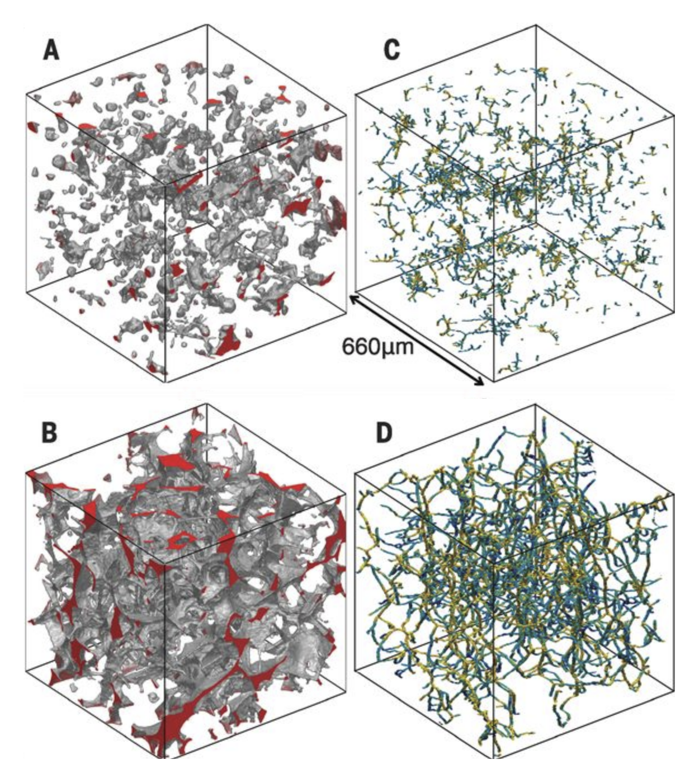
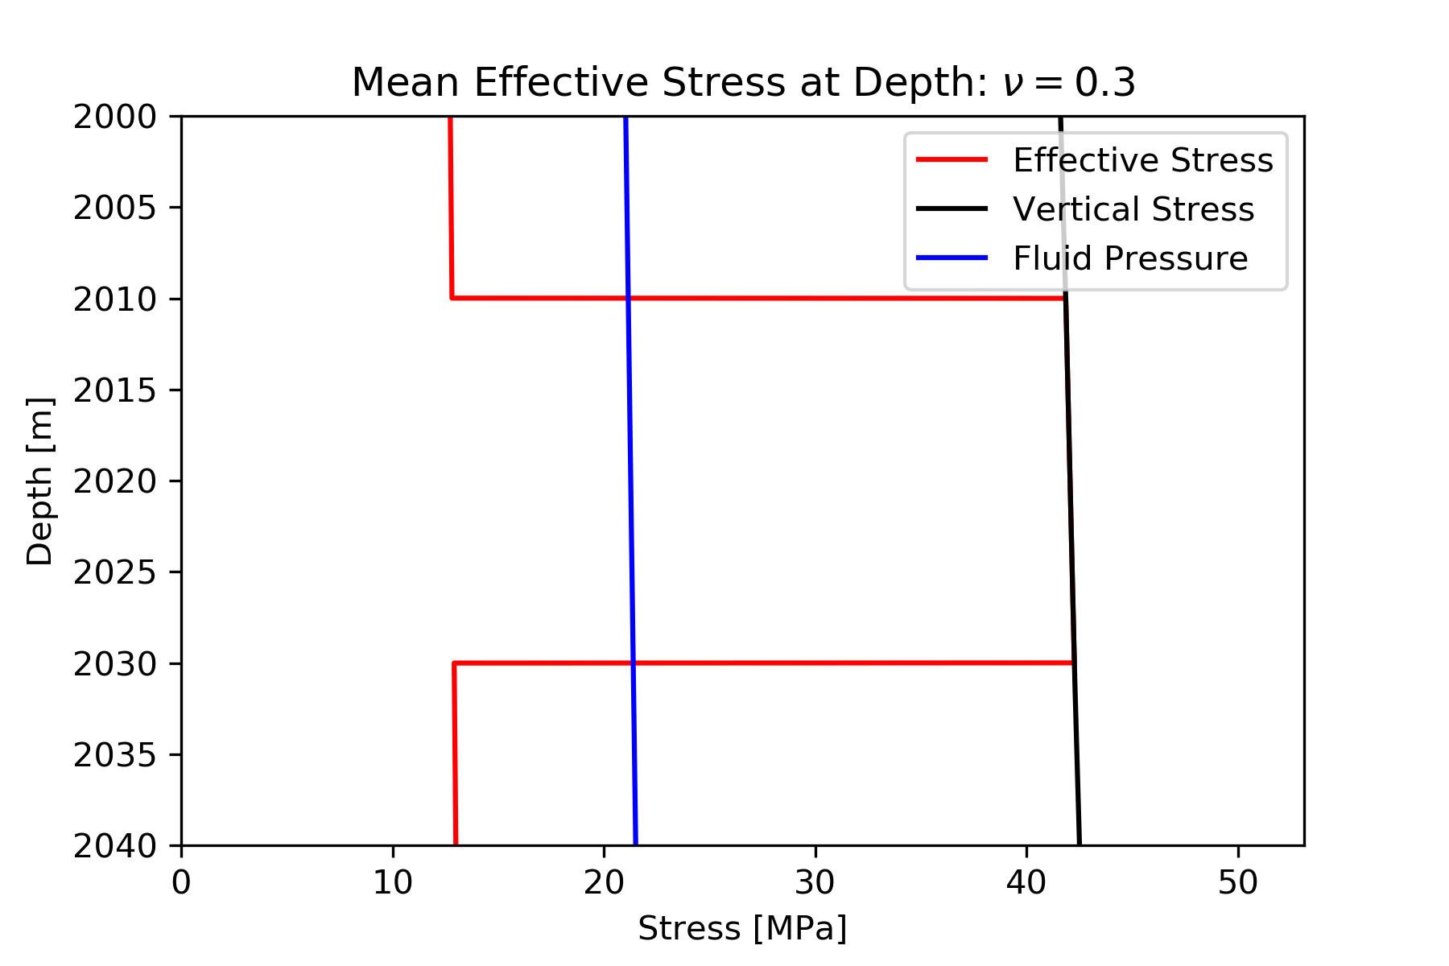
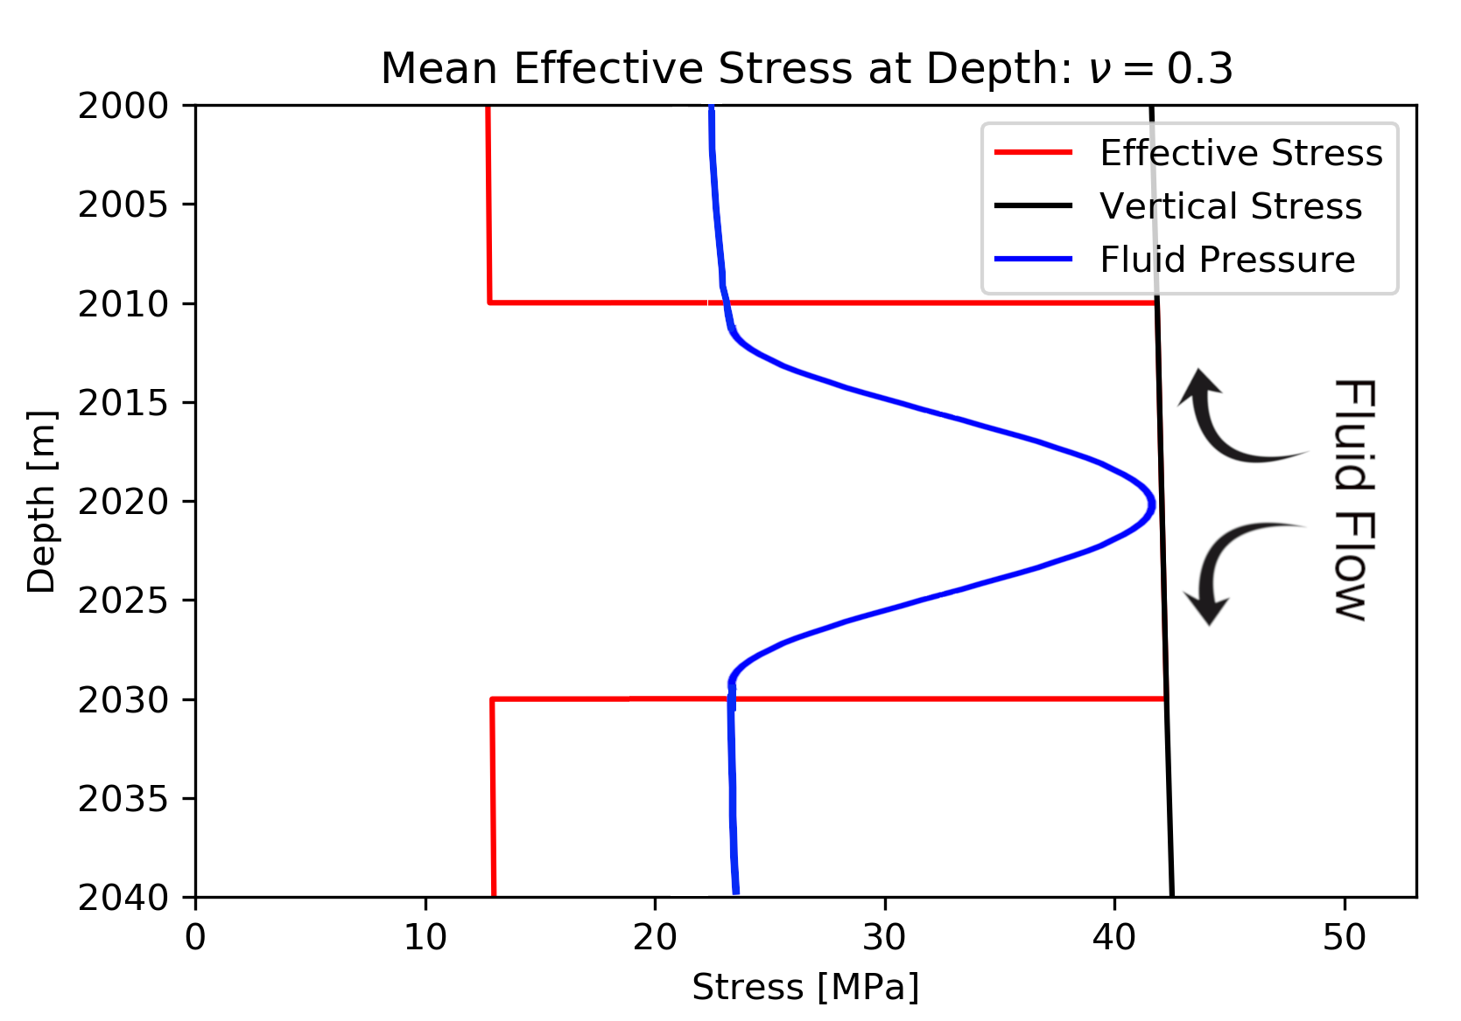
Modeling Episodic Fluid Migration in Salt Basins
Preston D. Fussee-Durham¹, Marc A. Hesse^{1,2}
¹Department of Geological Sciences, ² Institute for Computational Engineering and Sciences, The University of Texas at Austin
Background
Research Questions
Discussion
Previous studies have documented the presence of migrated hydrocarbons in rock salt suggesting these stratigraphic traps have lost some of their sealing capacity; however, the mechanism for their emplacement is poorly understood. Typically, salt is assumed to undergo a form of visco-elasto-plastic deformation. On geologic timescales; however, salt is expected to behave as a highly viscous non-Newtonian fluid. The viscous nature of the salt body allows significant porosity changes that cannot be neglected and may therefore allow elevated fluxes of fluid to occur – providing a mechanism for the further drainage of pore fluids from underlying reservoirs.
Question 1: What are the hydro-dynamical consequences of assuming salt behaves as a highly viscous fluid?
Question 2: Under such a deformation mechanism, what conditions lead to the failure of a salt seal?
Here, the stress within the sandstone layers was computed based on linear elasticity with a Poisson's ratio of 0.3. The stress within the salt layer, however, was computed based on a mixing rule for fluids. Because the salt behaves as a highly viscous fluid and the porosity is very low, the ductile salt matrix bears the majority of the overburden stress. Near lithostatic fluid pressures in this portion of the domain are of interest as it implies both upward and downward flow, restricting fluid migration into the salt deposit. These results do not evolve the porosity nor do they account for changes in pore pressure due to overlying sedimentation.
Governing Equations
To understand the conditions under which pore fluids can enter salt on geologic timescales, a numerical model for single-phase flow in porous media is developed. The model is composed of a viscous salt layer sandwiched between overlying and underlying elastic sandstone reservoirs. The entire domain is subjected to compression by continuous sedimentation and results in the consolidation of the elastic reservoirs. Below are the strong forms of the governing equations used in this study.
Future Work
Observations: Ara Salt, Oman
Fluid Pressure (Elastic):
In this study, equations were presented which couple an elastic and viscous domain. The overlying sedimentation should elevate fluid pressure beneath the salt deposit and overcome the initial downward flow of fluid. In the scenario whereby the fluid pressure beneath the salt deposit approaches the lithostatic pressure, the porous salt matrix will expand, inflating the porosity and the associated flux of fluid. Future work will include solving the variational form of the governing equations numerically. Upon doing so, further model analysis will reveal whether elevated fluxes of fluid are observed relative to the background fluid flow.
Observations of oil stained rock salt from the Ara Group
Fluid Pressure (Viscous):
Porosity Evolution (Viscous):
Acknowledgements
Connected Pore Networks in Salt
Preliminary Results: Stress Analysis
Thank you to the Jackson School of Geosciences Undergraduate Honors Research Program, Dr. Marc Hesse, Dr. Omar Ghattas, Dr. Nicolas Espinoza, and Evan Ramos for their support and contributions to this research.
Experiments on synthetic rock salt suggest connected pore networks exist under reservoir conditions and therefore, fluid flow may occur.
Exp-I (Top):
P = 20 MPa and T = 100°C
Exp-II (Bottom):
P = 100 MPa and T = 275°C
A & B: 3D reconstruction
of the pore network
C & D: Skeletonized pore
network extracted from the
reconstructed 3D volume
Below is a stress analysis of the model domain. The fluid pressure is initially hydrostatic (left); however, upon solving the equations above, the viscous nature of the salt body creates elevated fluid pressures (right).
References
[1] MS Appold and JA Nunn. Numerical models of petroleum migration via buoyancy-driven porosity waves in viscously deformable sediments. Geofluids, 2:233–247, 2002.
[2] Soheil Ghanbarzadeh, Marc A Hesse, Maˇsa Prodanovi ́c, and James E Gardner. Deformation-assisted fluid percolation in rock salt. Science, 350(6264):1069–1072, 2015.
[3] Jacob S Jordan, Marc A Hesse, and John F Rudge.On mass transport in porosity waves. Earth and Planetary Science Letters, 485:65–78, 2018.
[4] Ajit Joshi, Martin S Appold, and Jeffrey A Nunn. Evaluation of solitary waves as a mechanism for oil transport in poroelastic media: A case study of the south eugene island field, gulf of mexico basin. Marine and Petroleum Geology, 37:53–69, 2012.
[5] John Warren. Salt as a fluid seal: Article 2 of 4: Internal fluid sources. 01 2016.
(Ghanbarzadeh et al., 2015)
Notes:
Research conducted by Young et al., 2017 put forward an innovative technique for identification and characterization of desert shrubs L. tridentata and A. dumosa using multi-spectral image analysis, yielding >65 million individual plant locations and properties.

